Slide 1
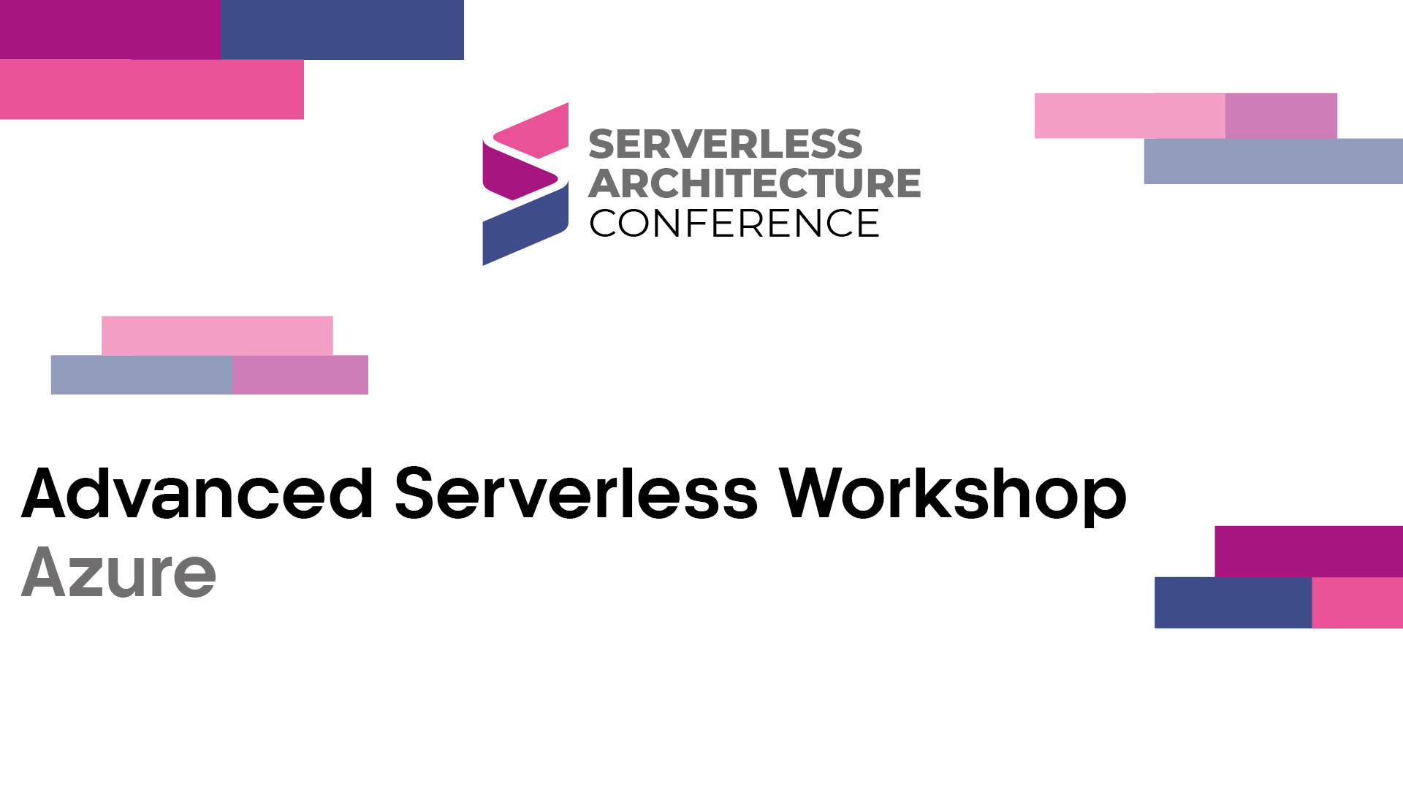

Slide 2






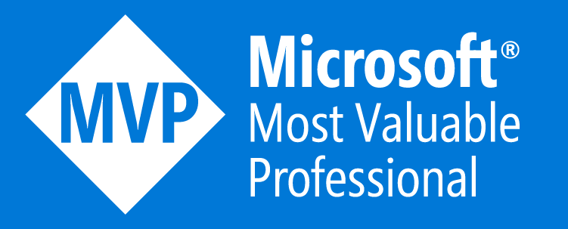
Who is Chad Green
chadgreen@chadgreen.com
TaleLearnCode
ChadGreen.com
ChadGreen & TaleLearnCode
ChadwickEGreen

Slide 3

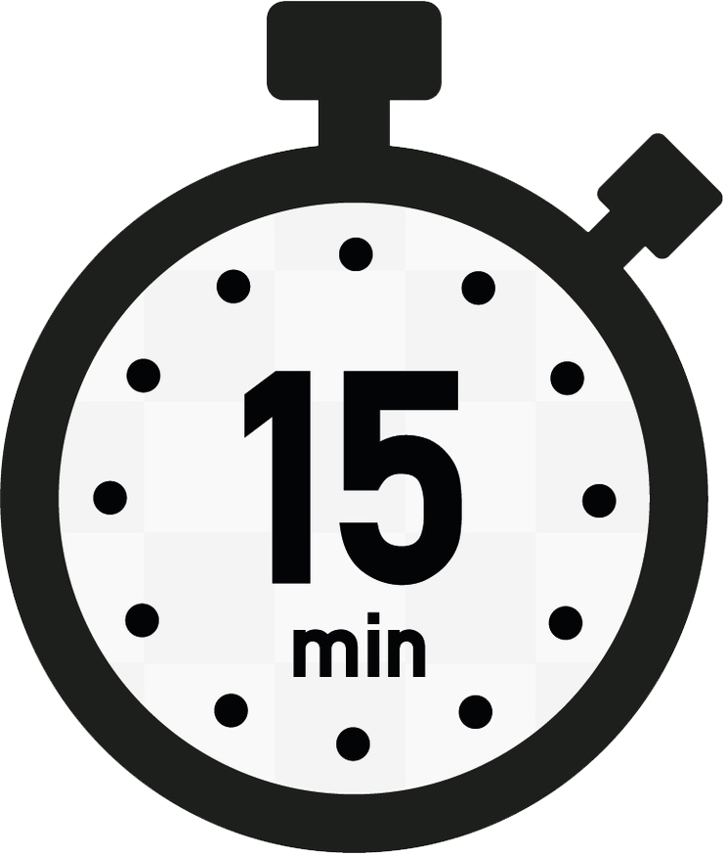
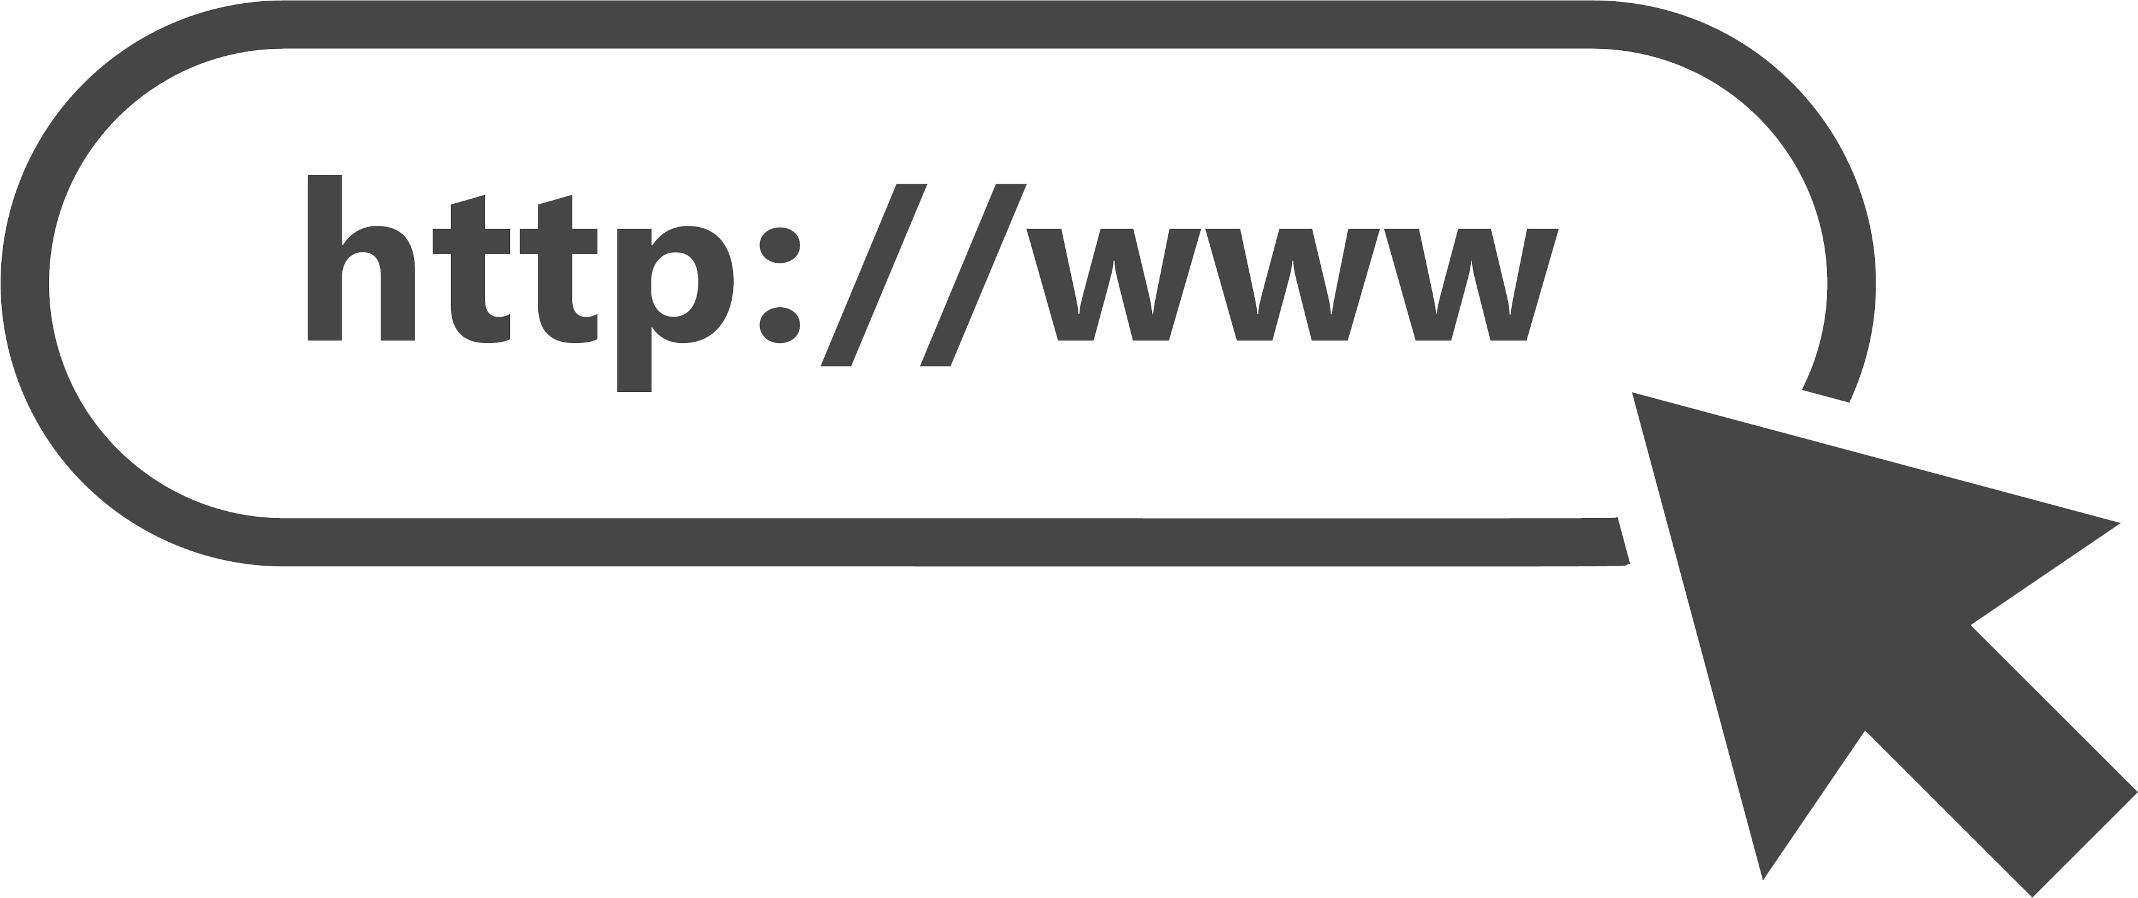




Simple Serverless Functionality
Some Process

Slide 4


CRUD Microservice

Slide 5
CRUD Microservice

Slide 6
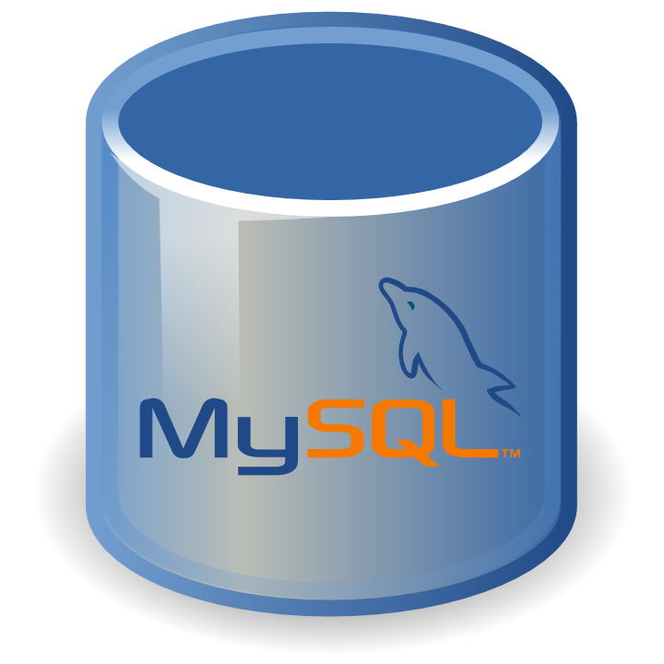
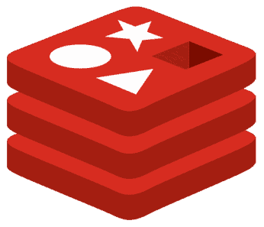
CRUD Microservice

Slide 7
Random Quote Generator
Add Channel
Channels
Add Quote
Quotes

Slide 8
Random Quote Generator
Add Channel
Channels
Add Quote
Quotes
Get Random Quote

Slide 9

Random Quote Generator
Add Channel
Channels
Add Quote
Quotes
Get Random Quote
Random Quote Timer

Slide 10




Replicating Data
Web
Application
.NET
Services Layer
Primary
Data Store
Change Feed
Monitor
Reporting
Database
Reporting
Dashboard

Slide 11



Real-Time Reporting
Medical Student
Testing
Website
Event
Hub
Stream Analytics
Power BI
Application
Database
Event Monitor
Answers

Slide 12











Glennis Platform
Portfolio
Sales
Leasing &
Billing
Resident
Care
eMAR
Resident
Experience
Quality
Financials
Insights

Slide 13
Glennis Platform
Portfolio
Sales
Leasing &
Billing
Resident
Care
eMAR
Resident
Experience
Quality
Financials
Insights

Slide 14
Glennis Platform
Glennis Portfolio
Portfolio Management
Care and Services Management
Pricing Management
Marketing Data Management
Marketing APIs

Slide 15
Glennis Platform
Glennis Portfolio
Portfolio Management
Care and Services Management
Pricing Management
Marketing Data Management
Marketing APIs

Slide 16
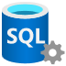
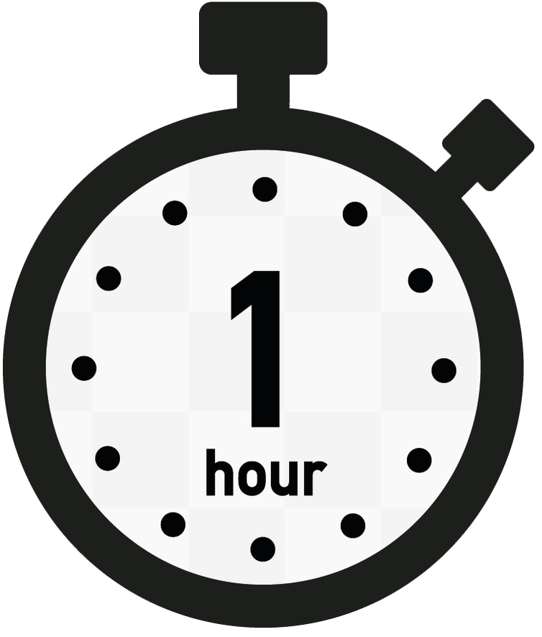



Glennis Portfolio
Portfolio
Portfolio API
Leasing &
Billing
Customer Legacy
Event Hubs
Serverless API
Customer Applications
Synchronizer
Event Monitor
Image Resizer
Marketing Websites
Queue
Customer
Queue
Portfolio
Marketing API
Chat Bots
Response
Builder
Cached
Responses
API Management
Custom
Marketing API
Google Ads

Slide 17
Microsoft Azure Serverless Offerings & Tools
Advanced Serverless Workshop: Azure

Slide 18

Azure Serverless Offerings & Tools
Azure Kubernetes Service
Compute
Notes:
Build applications faster by eliminating the need to manage the infrastructure that runs your code and containers.
Serverless Kubernetes
Elastically provision pods inside container instances that start in seconds without the need to manage additional compute resources. Create serverless, Kubernetes-based applications using the orchestration capabilities of Azure Kubernetes Services (AKS) and AKS virtual nodes, which are built on the open-source Virtual Kubelet project. Get the best of an event-driven approach by adding KEDA event-driven autoscaling to your AKS cluster. KEDA is an open-source component that enables containers to process events directly from event sources, and it provides the ability to scale to zero.

Slide 19

Azure Serverless Offerings & Tools
Azure Kubernetes Service
Azure Container Apps
Compute
Notes:
Serverless Container Microservices
Deploy containerized applications without managing complex infrastructure with Azure Container Apps. Write code using your preferred programming language and/or framework, and build microservices with full support for Distributed Application Runtime (Dapr). Scale dynamically based on HTTP traffic or events powered by Kubernetes Event-Driven Autoscaling (KEDA).

Slide 20
Azure Serverless Offerings & Tools
Azure Kubernetes Service
Azure Container Apps
Azure App Service
Compute
Notes:
Serverless Application Environments
Run and scale web, mobile, and API applications on the platform of your choice – in a high-productivity, fully managed environment – with Azure App Service.

Slide 21
Azure Serverless Offerings & Tools
Azure Kubernetes Service
Azure Container Apps
Azure App Service
Azure Functions
Compute
Notes:
Serverless Functions
Execute code – written in the language of your choice – with Azure Functions an event-driven compute experience. Scale on demand and pay only for the time your code is executed. Available as a managed service in Azure and Azure Stack, the open source Functions runtime also works on multiple destinations, including Kubernetes, Azure IoT Edge, on-premises, and even in other clouds.

Slide 22

Azure Serverless Offerings & Tools
Azure Logic Apps
Workflows and Integration
Notes:
Create new applications by orchestrating event-based serverless architectures. Build connected services more easily using a simple API façade that abstracts API implementation complexity.
Serverless workflow orchestration
Integrate data and apps instead of writing complex glue code between disparate systems. Visually create serverless workflows with Azure Logic Apps and use your own APIs, serverless functions, or out-of-the-box software as a service (SaaS) connectors, including Salesforce, Microsoft Office 365, and Dropbox.

Slide 23
Azure Serverless Offerings & Tools
Azure Logic Apps
API Management
Workflows and Integration
Notes:
Serverless API management
Publish, secure, transform, maintain, and monitor APIs with Azure API Management, a fully managed service that offers a usage model designed and implemented to be an organic fit for serverless applications.

Slide 24

Azure Serverless Offerings & Tools
Azure Logic Apps
API Management
Azure Event Grid
Workflows and Integration
Notes:
Serverless messaging
Simplify event-based application scenarios with Azure Event Grid. Connect serverless logic to events coming from multiple Azure services and external sources using the CloudEvents schema. Build distributed and scalable cloud solutions with connections across private and public cloud environments with the Azure Service Bus messaging infrastructure.

Slide 25

Azure Serverless Offerings & Tools
Azure Cognitive Services
AI and Machine Learning
Notes:
Infuse your serverless applications with ready-to-use AI and machine learning algorithms. Improve productivity and reduce costs with autoscaling compute and DevOps for machine learning.
Cognitive Computing
Enable your serverless apps to see, hear, speak, understand and interpret your user needs through natural methods of communication using Azure Cognitive Services via an API or deployed as containers on Kubernetes.

Slide 26

Azure Serverless Offerings & Tools
Azure Cognitive Services
Azure Bot Services
AI and Machine Learning
Notes:
Conversation Bots
Us Azure Bots Services to build intelligent bots that interact naturally with your users through channels such as text/SMS, Skype, Microsoft Teams, Slack, Office 365, and Twitter.

Slide 27

Azure Serverless Offerings & Tools
Azure Cognitive Services
Azure Bot Services
Azure Machine Learning
AI and Machine Learning
Notes:
Machine Learning Models
Build, train, and deploy models on Azure Machine Learning, from the cloud to the edge.

Slide 28
Azure Serverless Offerings & Tools
Azure SQL Database
Database
Notes:
Azure SQL Database serverless
Build apps faster, optimize price-performance, and simplify performance management for relational databases using Azure SQL Database serverless. Automatically scale compute based on workload demand and pay only for compute used per second. For further cost savings, automatically pause serverless databases and pay only for storage during inactive periods, then automatically resume when workload activity returns.

Slide 29
Azure Serverless Offerings & Tools
Azure SQL Database
Azure Cosmos DB
Database
Notes:
Azure Cosmos DB
Use Azure Cosmos DB, a globally distributed, massively scalable, multi-model database service, to create database triggers, input binds, and output bindings.

Slide 30
Azure Serverless Offerings & Tools
Azure Blob Storage
Storage
Notes:
Azure Serverless Storage
Build static web applications on Azure Blob storage or use it as massively scalable storage for unstructured data. Leverage storage events to respond to operations on blobs with multiple serverless architectures. Blob events are pushed through Event Grids to subscribers using Functions, Logic Apps, or even your own custom HTTP listener.

Slide 31

Azure Serverless Offerings & Tools
Azure Monitor
Monitoring
Notes:
Azure Serverless Monitoring
As serverless eliminates traditional infrastructure management tasks, it’s more important than ever that developers have the right instrumentation in place to help debug serverless applications. Gain full observability into your serverless applications using Azure Monitor, an extensible application performance management service to monitor your applications. Collect, analyze, and act on telemetry from your cloud and on-premises environments to maximize the availability and performance of your applications.

Slide 32
Azure Serverless Offerings & Tools
Azure Stream Analytics
Analytics
Notes:
Azure Serverless Analytics
Easily develop and run massively parallel real-time analytics on multiple streams of data – include IoT – using Azure Stream Analytics. With no infrastructure to manage, process data on demand, scale instantly, and only pay per job. Quickly build real-time dashboards with Microsoft Power BI for a live command and control view.

Slide 33


Azure Functions
Code
Events + data

Slide 34
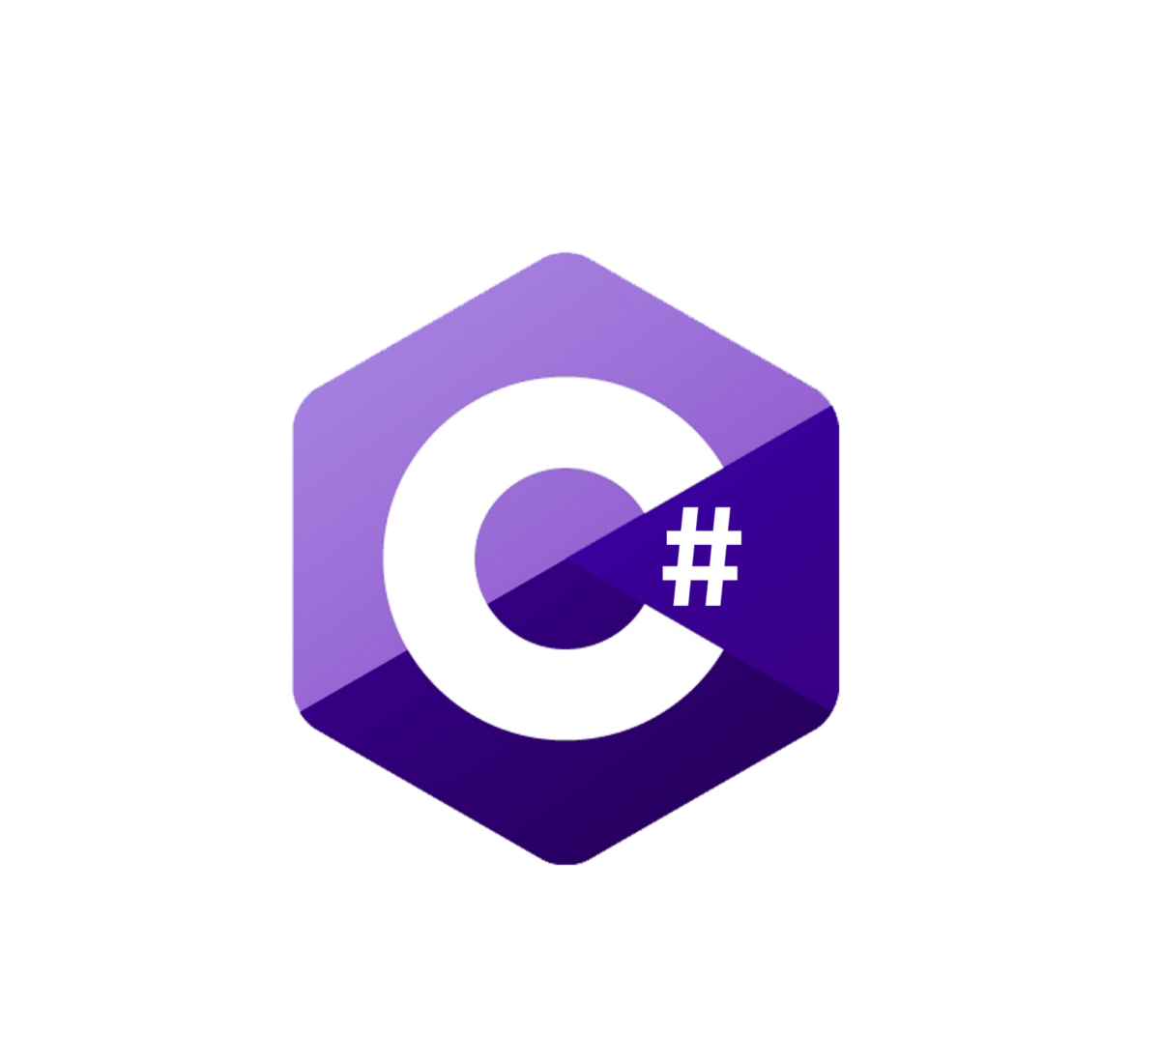



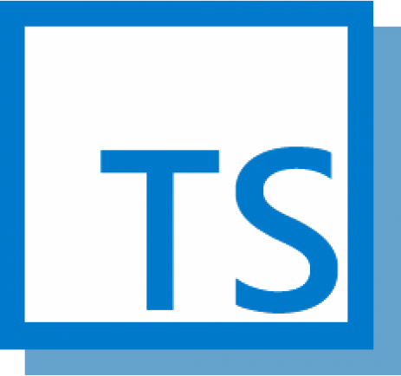

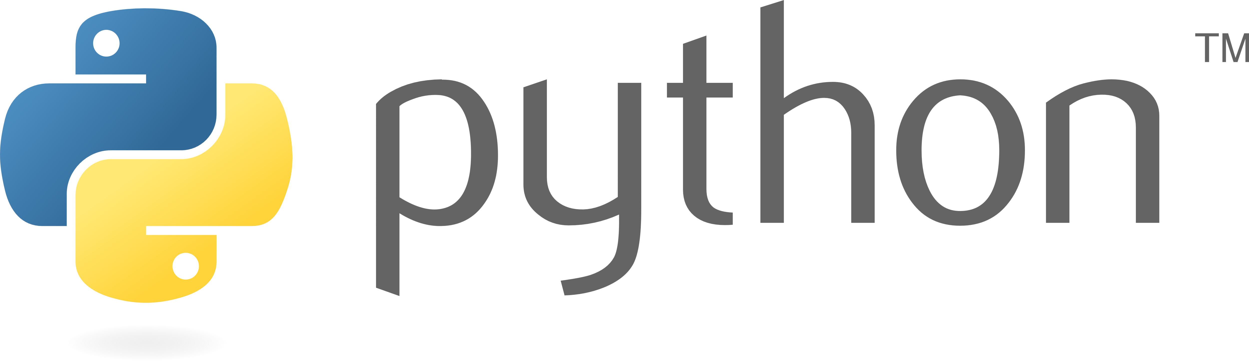
Choice of Language
Notes:
Choice of language: Azure Functions is a polyglot solution which allows you to write functions in not just C#, F#, and JavaScript, but also Java, Python, TypeScript, and even PowerShell
TypeScript supported through transpiling to JavaScript

Slide 35


Bring your own dependencies
Notes:
Bring your own dependencies: Functions support both NuGet and NPM, so you can use your favorite libraries.

Slide 36
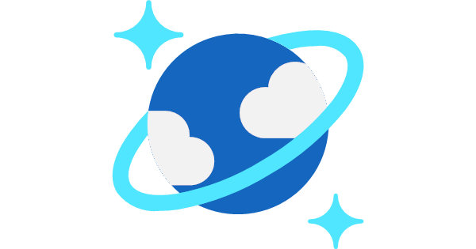








Simplified Integration
Notes:
Simplified integration: Easily leverage Azure services and software-as-a-service (SaaS) offerings. These services can trigger your function and start execution or they can serve as input and output for your code.
Such services include Cosmos DB, Event Hubs, Event Grid, Mobile Apps, Notification Hubs, Service Bus, Azure Storage, GitHub, and Twilio SMS messages
Azure Services
CosmosDB
Event Hubs
Event Grid
Notifications Hub
Azure Storage (blob, queue)
3rd Party Services
RabbitMQ
GitHub
Twillio

Slide 37

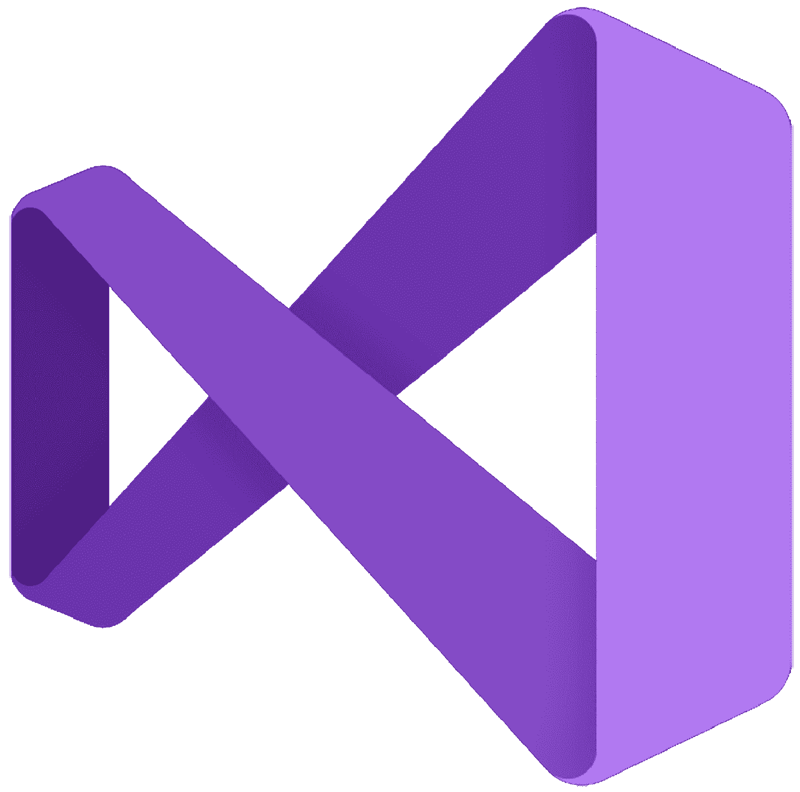
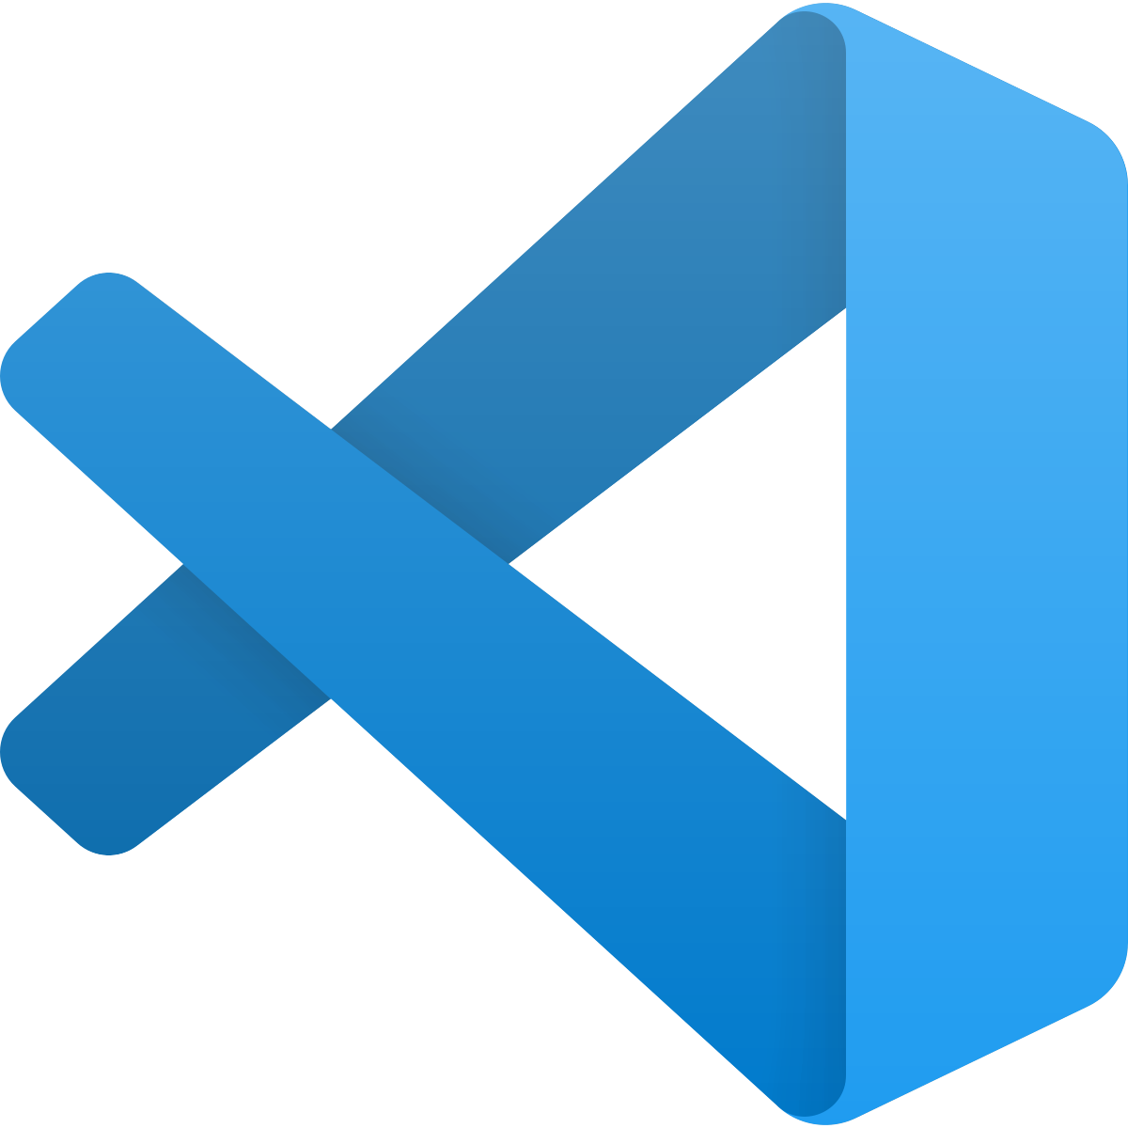
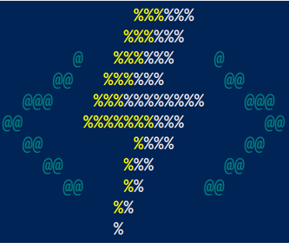


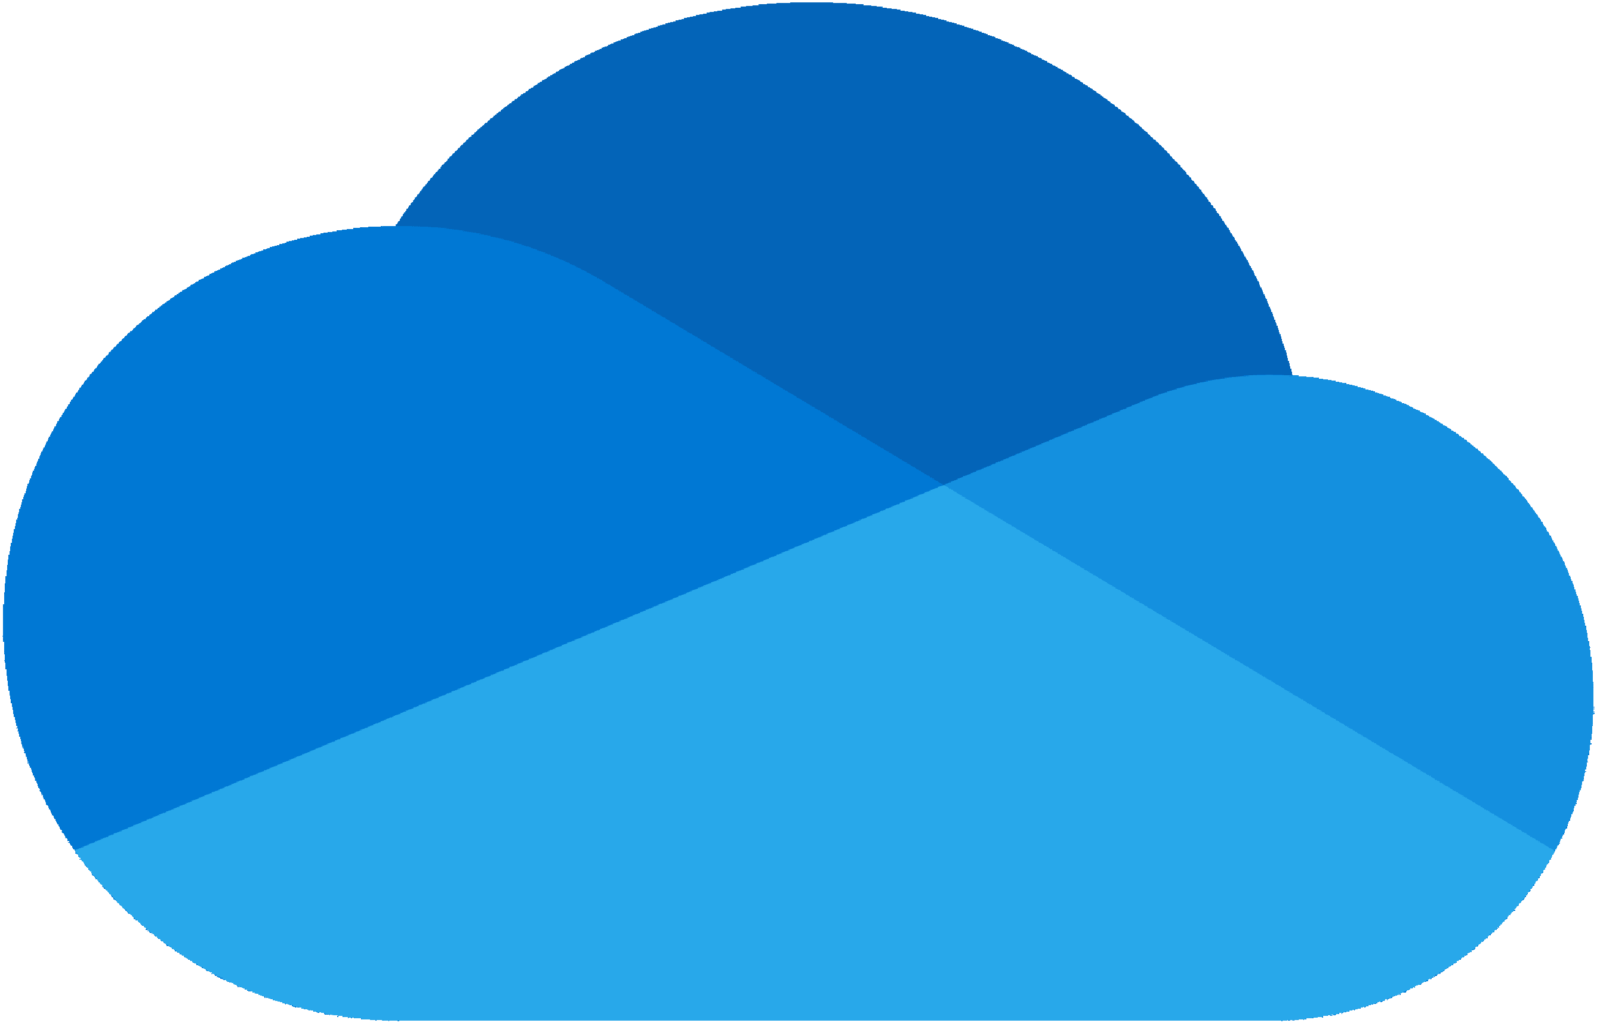



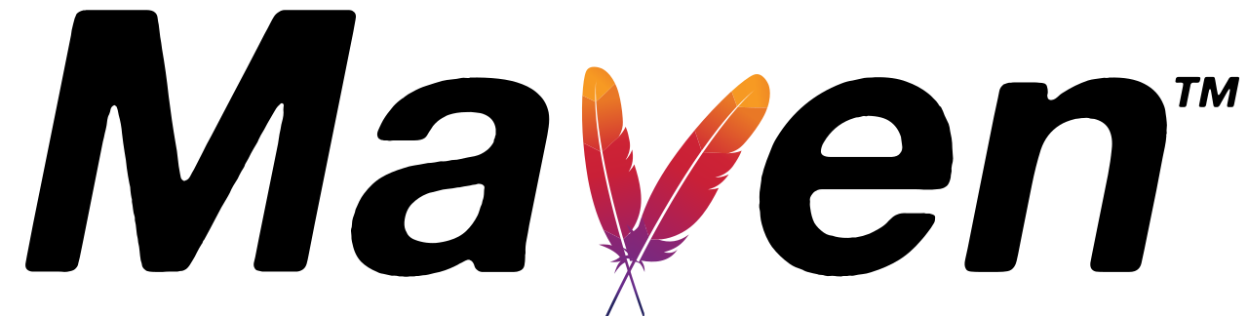
Flexible Development
Notes:
Flexible development: Code your functions right in the portal or set up continuous integration and deploy your code through GitHub, Visual Studio Team Services, and other support development tools including OneDrive, Bitbucket, Dropbox, and either a local or external Git repository

Slide 38
Many Deployment Options
Consumption
Serverless
Notes:
Pay only for what you use! Metering is per execution and per Gb second.

Slide 39

Many Deployment Options
App Service
Plan
Consumption
Serverless
Free, Basic, Standard, Premium
Notes:
All the advantages of Functions with the SLA and ‘always on’ feature of an App Service Plan

Slide 40

Many Deployment Options
App Service
Plan
App Service
Environment
Consumption
Serverless
Free, Basic, Standard, Premium
Network Isolation
Notes:
Your own dedication cloud environment with network isolation for apps, higher scale, and the ability to connect securely to local vNets.

Slide 41

Many Deployment Options
App Service
Plan
App Service
Environment
Consumption
Azure Stack
Serverless
Free, Basic, Standard, Premium
Network Isolation
On Premises
Notes:
Leverage cloud innovations in on-premises infrastructure. Azure Stack brings the power of Azure to your data centers.

Slide 42

Many Deployment Options
Azure
Functions
Runtime
App Service
Plan
App Service
Environment
Consumption
Azure Stack
Serverless
Free, Basic, Standard, Premium
Network Isolation
On Premises
Functions on Your Server
Notes:
Run your Azure Functions on our local server (without the rest of Azure).

Slide 43

Many Deployment Options
Azure
Functions
Runtime
App Service
Plan
App Service
Environment
Azure
IoT Edge
Consumption
Azure Stack
Serverless
Free, Basic, Standard, Premium
Network Isolation
On Premises
Functions on Your Server
On Devices
Notes:
Run on IoT devices by deploying custom modules.

Slide 44
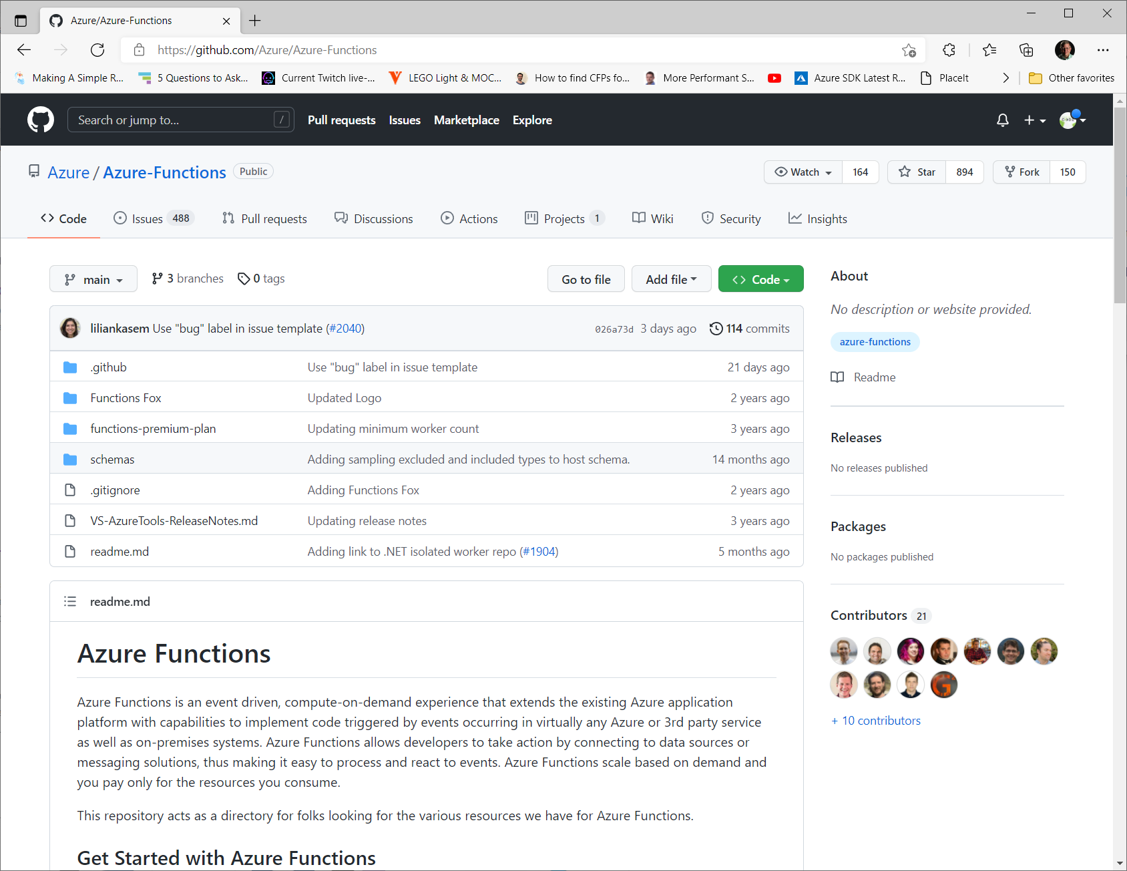
Open-Source

Slide 45
Supported Triggers and Bindings

Slide 46


HTTP
Tigger
Input
Output
Consumption
Premium
Dedicated
C# In-Process
C# Isolated
Java
JavaScript
PowerShell
Python
Trigger
Bindings

Slide 47
Blob
Tigger
Input
Output
Consumption
Premium
Dedicated
C# In-Process
C# Isolated
Java
JavaScript
PowerShell
Python
Trigger
Bindings

Slide 48
Cosmos DB
Tigger
Input
Output
Consumption
Premium
Dedicated
C# In-Process
C# Isolated
Java
JavaScript
PowerShell
Python
SQL API
Trigger
Bindings

Slide 49
Azure SQL (Preview)
Tigger
Input
Output
Consumption
Premium
Dedicated
C# In-Process
C# Isolated
Java
JavaScript
PowerShell
Python
Action Trigger
Trigger
Bindings

Slide 50
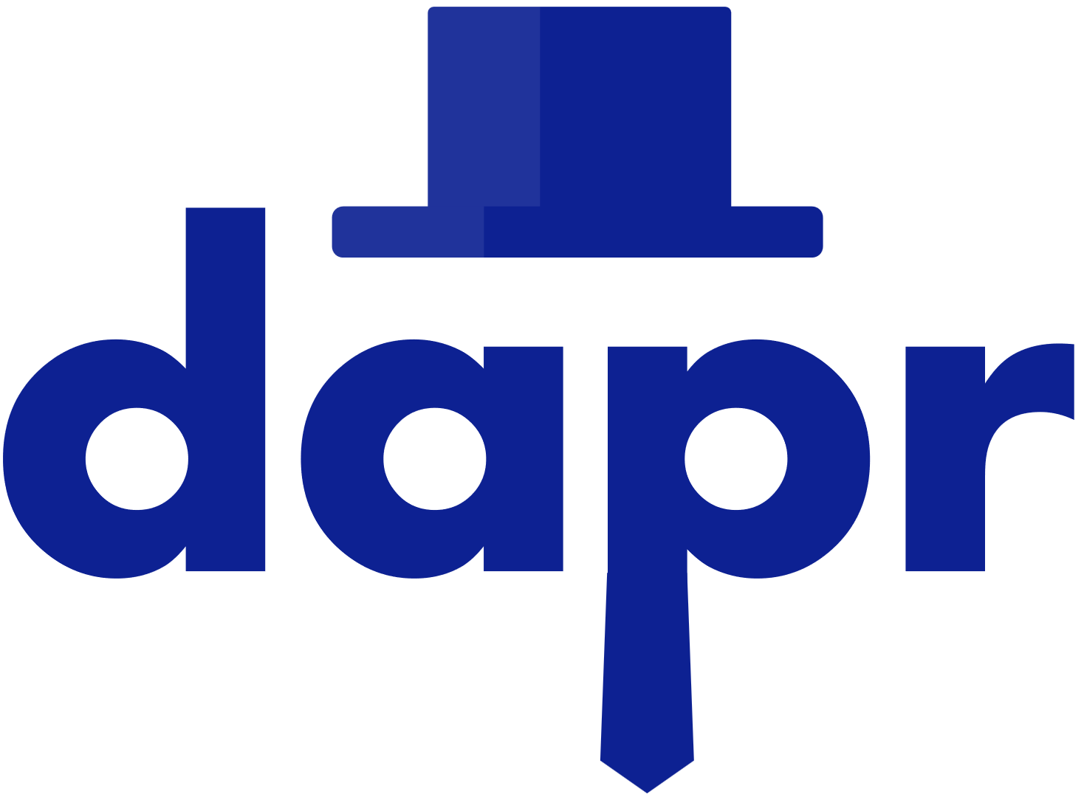
Dapr
Supported only in
Kubernetes, IoT Edge,
and other self-hosted
modes only
Tigger
Input
Output
Consumption
Premium
Dedicated
C# In-Process
C# Isolated
Java
JavaScript
PowerShell
Python
Trigger
Bindings
Notes:
⚠️ This extension is currently in preview and not recommended for production. ⚠️
The Azure Functions Dapr extension allows you to easily interact with the Dapr APIs from an Azure Function using triggers and bindings. This extension is supported in any environment that supports running Dapr and Azure Functions - primarily self-hosted and Kubernetes modes.

Slide 51
Event Grid
Tigger
Input
Output
Consumption
Premium
Dedicated
C# In-Process
C# Isolated
Java
JavaScript
PowerShell
Python
Trigger
Bindings
Notes:
Event handlers receive and process events

Slide 52
Event Hub
Tigger
Input
Output
Consumption
Premium
Dedicated
C# In-Process
C# Isolated
Java
JavaScript
PowerShell
Python
Trigger
Bindings

Slide 53

IoT Hub
Tigger
Input
Output
Consumption
Premium
Dedicated
C# In-Process
C# Isolated
Java
JavaScript
PowerShell
Python
Trigger
Bindings

Slide 54

Kafka
Tigger
Input
Output
Consumption
Premium
Dedicated
C# In-Process
C# Isolated
Java
JavaScript
PowerShell
Python
Trigger
Bindings
Notes:
The Kafka extension for Azure Functions lets you write values out to Apache Kafka topics by using an output binding. You can also use a trigger to invoke your functions in response to messages in Kafka topics.

Slide 55
Queue Storage
Tigger
Input
Output
Consumption
Premium
Dedicated
C# In-Process
C# Isolated
Java
JavaScript
PowerShell
Python
Trigger
Bindings
Notes:
Azure Functions can run as new Azure Queue storage messages are created and can write queue messages within a function.

Slide 56

RabbitMQ
Tigger
Input
Output
Consumption
Premium
Dedicated
C# In-Process
C# Isolated
Java
JavaScript
PowerShell
Python
Trigger
Bindings
Notes:
The Azure Functions RabbitMQ extension allows you to send and receive messages using the RabbitMQ API with Functions.

Slide 57

SendGrid
Tigger
Input
Output
Consumption
Premium
Dedicated
C# In-Process
C# Isolated
Java
JavaScript
PowerShell
Python
Action Trigger
Trigger
Bindings

Slide 58

Service Bus
Tigger
Input
Output
Consumption
Premium
Dedicated
C# In-Process
C# Isolated
Java
JavaScript
PowerShell
Python
Trigger
Bindings
Notes:
Integrating with Service Bus allows you to build functions that react to and send queue or topic messages.

Slide 59

SignalR
Tigger
Input
Output
Consumption
Premium
Dedicated
C# In-Process
C# Isolated
Java
JavaScript
PowerShell
Python
Trigger
Bindings
Notes:
Real-time messages

Slide 60
Table Storage
Tigger
Input
Output
Consumption
Premium
Dedicated
C# In-Process
C# Isolated
Java
JavaScript
PowerShell
Python
Cosmos DB support
in preview
Action Trigger
Trigger
Bindings
Notes:
Integrating with Azure Tables allows you to build functions that read and write data using the Tables API for Azure Storage and Cosmos DB.

Slide 61
Timer
Tigger
Input
Output
Consumption
Premium
Dedicated
C# In-Process
C# Isolated
Java
JavaScript
PowerShell
Python
Trigger
Notes:
A timer trigger lets you run a function on a schedule.

Slide 62

Twilio
Tigger
Input
Output
Consumption
Premium
Dedicated
C# In-Process
C# Isolated
Java
JavaScript
PowerShell
Python
Action Trigger
Trigger
Bindings

Slide 63

Warmup
Tigger
Input
Output
Consumption
Premium
Dedicated
C# In-Process
C# Isolated
Java
JavaScript
PowerShell
Python
Trigger
Notes:
Considerations:
Not available to apps running on the Consumption plan
Can only be one warmup trigger function per function app, and it cannot be invoked after the instance is already running
Only called during scale-out operations, not during restarts or other non-scale startups
Make sure you logic can load all required dependencies without relying on the warmup trigger; lazy loading is a good pattern to achieve this goal

Slide 64



Supported Bindings
Third Party Bindings
Custom Bindings

Slide 65
Durable Functions
Notes:
Durable Functions is an extension of Azure Functions that lets you write stateful functions in a serverless compute environment.

Slide 66
Durable Functions
Stateful Functions?
Orchestrated Workflows
Notes:
Durable Functions is an extension of Azure Functions that lets you write stateful functions in a serverless compute environment. The extension lets you define stateful workflows writing orchestrator functions and stateful entities by writing entity functions using the Azure Functions programming model. Behind the scenes, the extension manages state, checkpoints, and restarts for you, allowing you to focus on your business logic.
The primary use case for Durable Functions is simplifying complex, stateful coordination requirements in serverless applications. There are 6 typical application patterns that can benefit from Durable Functions.

Slide 67
Durable Functions
Patterns – Function Chaining
F1
F2
F3
F4
Notes:
In the function chaining pattern, a sequence of functions executes in a specific order. In this pattern, the output of one function is applied to the input of another function.
In this example, the values F1, F2, F3, and F4 are the names of activity functions. You can implement control flow by using normal imperative coding constructs. Code executes from the top down. The code can involve existing language control flow semantics, like conditionals and loops. You can include error handling logic in try/catch/finally blocks.

Slide 68
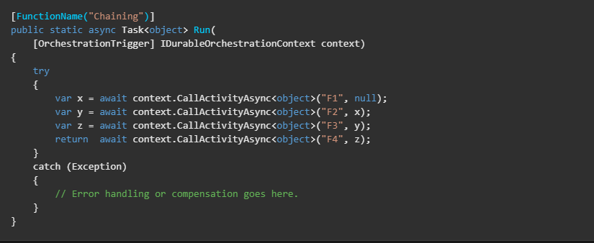
Durable Functions
Patterns – Function Chaining
Notes:
You can use the context parameter to invoke other functions by name, pass parameters, and return function output. Each time the code calls await, the Durable Functions framework checkpoints the progress of the function instance. If the process or virtual machine recycles midway through the execution, the function instance resumes from the preceding await call.

Slide 69
Durable Functions
Patterns – Fan out/fan in
F1
F3
F2
Notes:
In the fan out/fan in pattern, you execute multiple functions in parallel and then wait for all functions to finish. Often, some aggregation work is done on the results that are returned from the functions.
With normal functions, you can fan out by having the function send multiple messages to a queue. Fanning back in its much more challenging. To fan in, in a normal function, you write code to track when the queue-triggered functions end, and then store function outputs.
The Durable Function extension handles this pattern with relatively simple code:

Slide 70
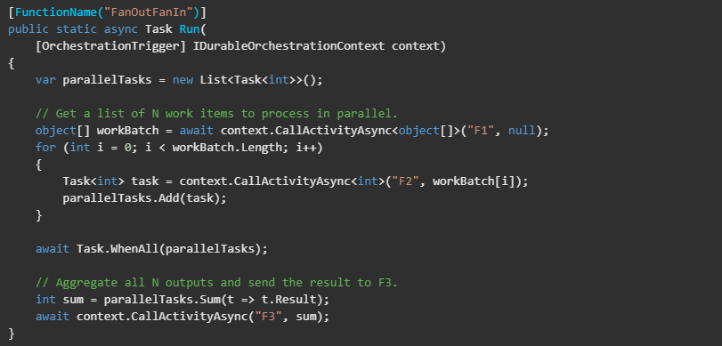
Durable Functions
Patterns – Fan out/fan in
Notes:
The fan-out work is distributed to multiple instances of the F2 function. The work is tracked by using a dynamic list of tasks. Task.WhenAll is called to wait for all the called functions to finish. Then, the F2 function outputs are aggregated from the dynamic task list and passed to the F3 function.
The automatic checkpointing that happens at the await call on Task.WhenAll ensures that a potential midway crash or reboot does not require restarting an already completed task.

Slide 71
Durable Functions
Patterns – Async HTTP APIs
Start
Do Work
GetStatus
Notes:
The async HTTP API pattern address the problem of coordinating the state of long-running operations with external clients. A common way to implement this pattern is by having an HTTP endpoint trigger the long-running action. Then, redirect the client to a status endpoint that the client polls to learn when the operation is finished.
Durable functions provides built-in support for this pattern, simplifying or even removing the code you need to write to intact with long-running function executions.

Slide 72
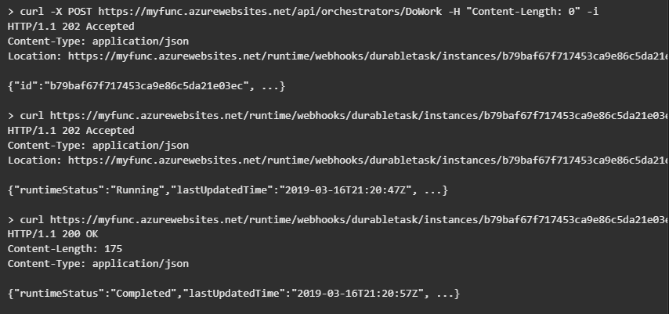
Durable Functions
Patterns – Async HTTP APIs
Notes:
This example shows REST commands that start an orchestrator and query its status.
Because the Durable Functions runtime manages state for you, you do not need to implement your own status-tracking mechanism.
The Durable Functions extension exposes built-in HTTP APIs that manage long-running orchestrations. You can alternatively implement this pattern yourself by using your own function triggers (such as HTTP, a queue, or Azure Event Hubs) and the orchestration client binding. For example, you might use a queue message to trigger termination. Or, you might use an HTTP trigger that’s protected by an Azure Active Directory authentication policy instead of the built-in HTTP APIs that use a generated key for authentication.

Slide 73
Durable Functions
Patterns – Monitor
Notes:
The monitor pattern refers to a flexible, recurring process in a workflow. AN example is polling until specific conditions are met. You can use a regular timer trigger to address a basic scenario, such as a periodic cleanup job, but its interval instance and managing instance lifetimes becomes complex. You can use Durable Functions to create flexible recurrence intervals, manage task lifetimes, and create multiple monitor processes from a single orchestration.
An example of the monitor pattern is to reverse the earlier HTTP ASI scenario. Instead of exposing an endpoint for an external client to monitor a long-running operation, the long-running monitor consumes an external endpoint, and then waits for a state to change.

Slide 74
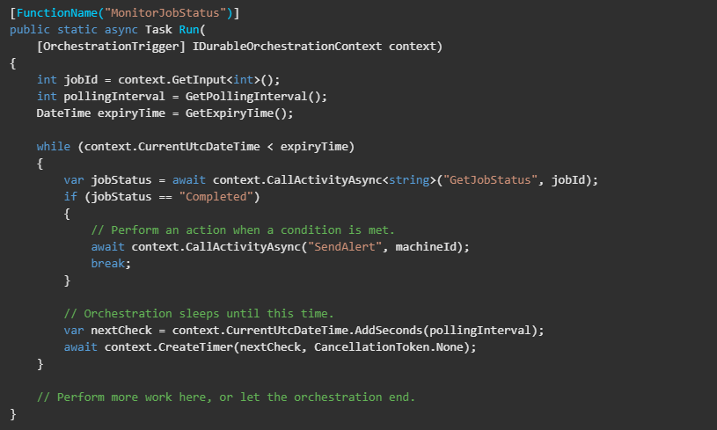
Durable Functions
Patterns – Monitor
Notes:
In a few lines of code, you can use Durable Functions to create multiple monitors that observe arbitrary endpoints. The monitors can end execution when a condition is met, or another function can use the durable orchestration client to terminate the monitors. You can change a monitor’s wait interval based on a specific condition (for example, exponential backoff).
When a request is received, a new orchestration instance is created for that job Id. The instance polls a status until either a condition is met or until a timeout expires. A durable timer controls the polling interval. Then, more work can be performed, or the orchestration can end.

Slide 75
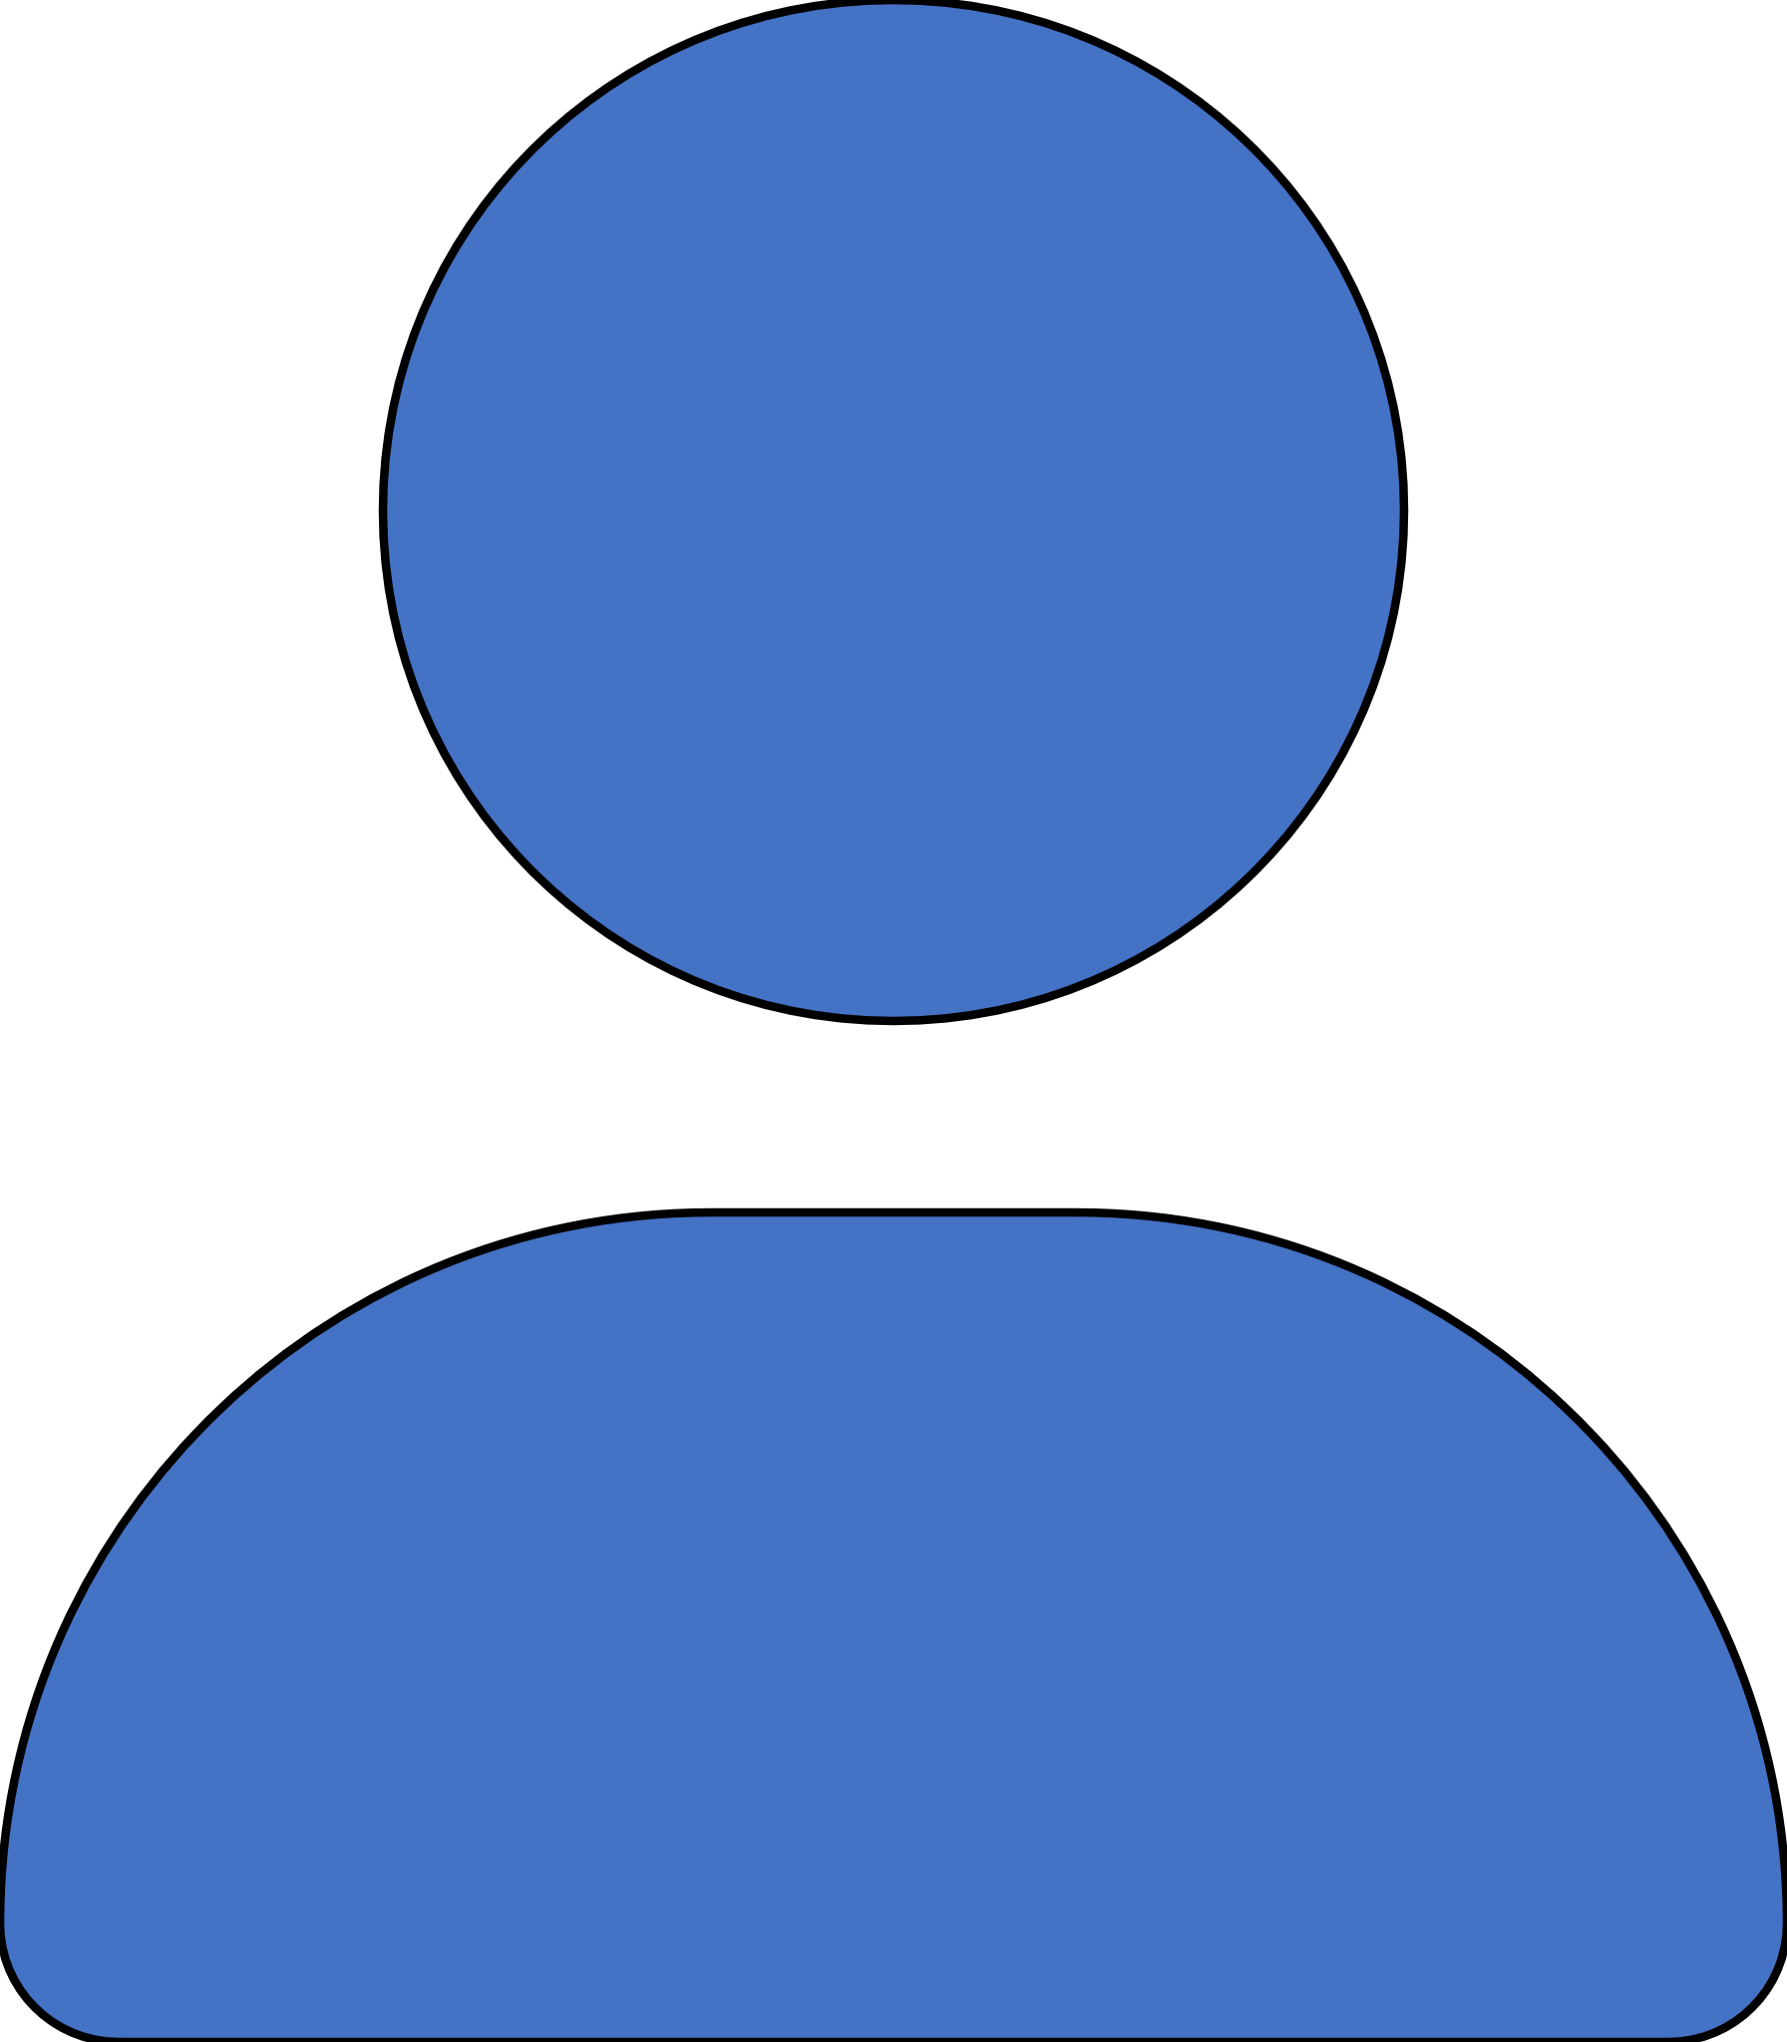
Durable Functions
Patterns – Human Interaction
Request
Approval
Process
Approval
Escalate
Notes:
Many automated processes involve some kind of human interaction. Involving humans in an automated process is tricky because people are not highlight available and as responsive as cloud services. An automated process might allow for this interaction by using timeouts and compensation logic.
An approval process is an example of a business process that involves human interaction. Approval from a manager might be required for an expense report that exceeds a certain dollar amount. If the manager doe not approve the expense report within 72 hours, an escalation process kicks in to get the approval from someone else.
You can implement this pattern in this example by using an orchestrator function. The orchestrator uses a durable timer to request approval. The orchestrator escalates if timeout occurs. The orchestrator waits for an external event, such as a notification that is generated by a human interaction.

Slide 76
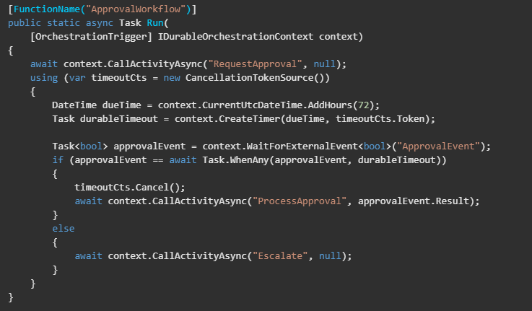
Durable Functions
Patterns – Human Interaction
Notes:
To create the durable timer, call context.CreateTimer. The notification is received by context.WaitForExternalEvent. Then, Task.WhenAny is called to decide whether to escalate (timeout happens first) or process the approval (the approval is received before the timeout).
NOTE: There is no charge for time spent waiting for external events when running in the Consumption plan.

Slide 77
Durable Functions
Patterns – Aggregator (stateful entities)
Notes:
The last pattern is about aggregating event data over a period of time into a single, addressable entity. In this pattern, the data being aggregated may come from multiple sources., may be delivered in batches, or may be scattered over long-periods of time. The aggregator might need to take action on event data as it arrives, and external clients may need to query the aggregated data.
The tricky thing about trying to implement this pattern with normal, stateless functions is that concurrency control becomes a huge challenge. Not only do you need to worry about multiple threads modifying the same data at the same time, you need to worry about ensuring that the aggregator only runs on a single VM at a time.

Slide 78
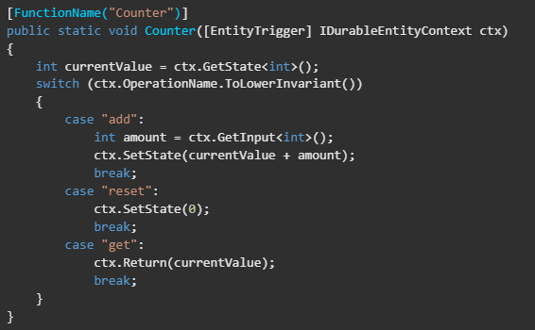
Durable Functions
Patterns – Aggregator (stateful entities)
Notes:
You can use Durable entities to easily implement this pattern as a single function.

Slide 79
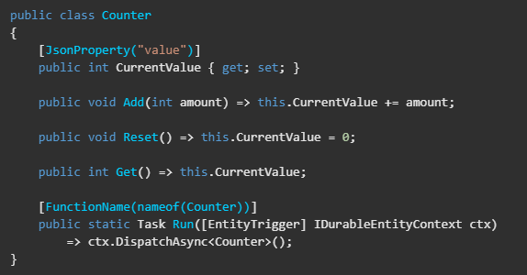
Durable Functions
Patterns – Aggregator (stateful entities)
Notes:
Durable entities can also be modeled as classes in .NET. This model can be useful if the list of operations is fixed and becomes large. The following example is equivalent implementation of the Counter entity using .NET classes and methods.

Slide 80
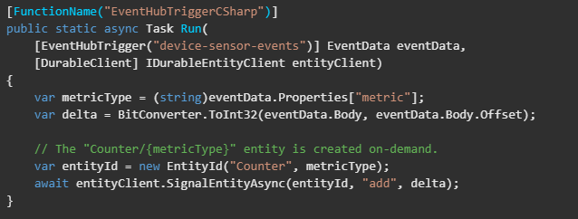
Durable Functions
Patterns – Aggregator (stateful entities)
Notes:
Clients can enqueue operations (also known as “signaling”) an entity function using the entity client binding.

Slide 81
In-Process vs Isolated Process
Advanced Serverless Workshop - Azure
Notes:
Previously Azure Functions has only supported a tightly integrated mode for .NET functions, which run as a class library in the same process as the host. This mode provides deep integration between the host process and the functions. For example, .NET class library functions can share binding APIs and types. However, this integration also requires a tighter coupling between the host process and the .NET function. For example, .NET functions running in-process are required to run on the same version of .NET as the Functions runtime. To enable you to run outside these constraints, you can now choose to run in an isolated process. This process isolation also lets you develop functions that use current .NET releases (such as .NET 7.0), not natively supported by the Functions runtime. Both isolated process and in-process C# class library functions run on .NET 6.0. To learn more, see Supported versions.
Because these functions run in a separate process, there are some feature and functionality differences between .NET isolated function apps and .NET class library function apps.

Slide 82
Benefits of Isolated Process
Fewer Conflicts
Full Control
Dependency Injection
Notes:
Fewer conflicts: because the functions run in a separate process, assemblies used in your app won't conflict with different version of the same assemblies used by the host process.
Full control of the process: you control the start-up of the app and can control the configurations used and the middleware started.
Dependency injection: because you have full control of the process, you can use current .NET behaviors for dependency injection and incorporating middleware into your function app.

Slide 83
Startup and Configuration
var host = new HostBuilder()
.ConfigureFunctionsWorkerDefaults(builder =>
{
builder
.AddApplicationInsights()
.AddApplicationInsightsLogger();
})
.ConfigureServices(s =>
{
s.AddSingleton<IHttpResponderService, DefaultHttpResponderService>();
})
.Build();

Slide 84
Middleware
var host = new HostBuilder()
.ConfigureFunctionsWorkerDefaults(workerApplication =>
{
// Register our custom middlewares with the worker
workerApplication.UseMiddleware<ExceptionHandlingMiddleware>();
workerApplication.UseMiddleware<MyCustomMiddleware>();
workerApplication.UseWhen<StampHttpHeaderMiddleware>((context) =>
{
// We want to use this middleware only for http trigger invocations.
return context.FunctionDefinition.InputBindings.Values
.First(a => a.Type.EndsWith("Trigger")).Type == "httpTrigger";
});
})
.Build();
Notes:
.NET isolated also supports middleware registration, again by using a model similar to what exists in ASP.NET. This model gives you the ability to inject logic into the invocation pipeline, and before and after functions execute.

Slide 85
ReadyToRun
<PropertyGroup>
<TargetFramework>net6.0</TargetFramework>
<AzureFunctionsVersion>v4</AzureFunctionsVersion>
<RuntimeIdentifier>win-x86</RuntimeIdentifier>
<PublishReadyToRun>true</PublishReadyToRun>
</PropertyGroup>
Notes:
You can compile your function app as ReadyToRun binaries. ReadyToRun is a form of ahead-of-time compilation that can improve startup performance to help reduce the impact of cold-start when running in a Consumption plan.

Slide 86
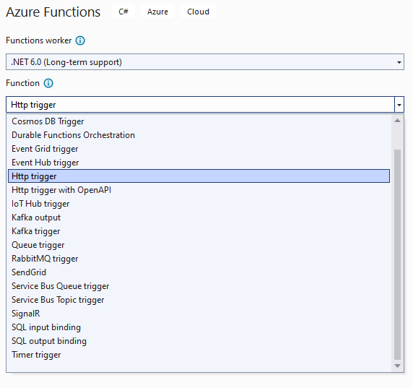
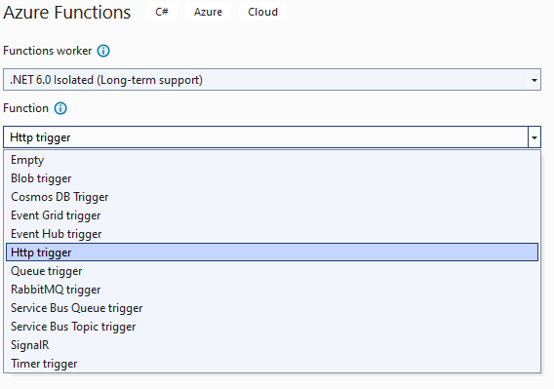
Not Everything Supported

Slide 87
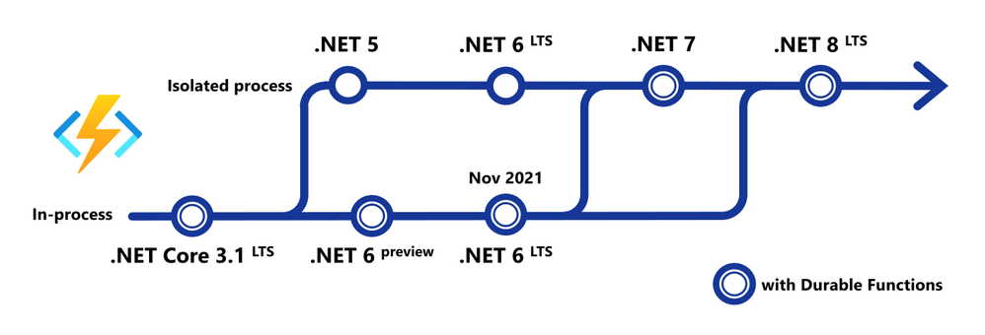
Timelines

Slide 88
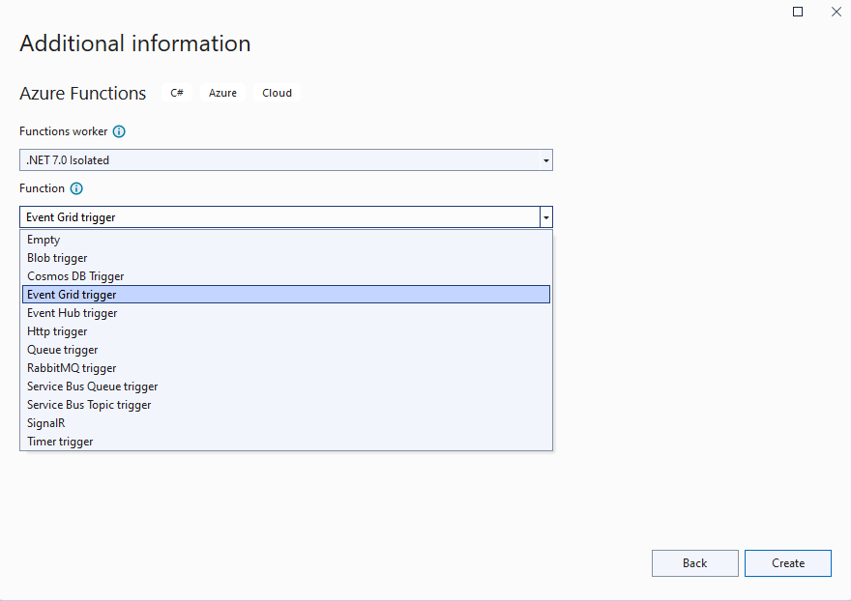
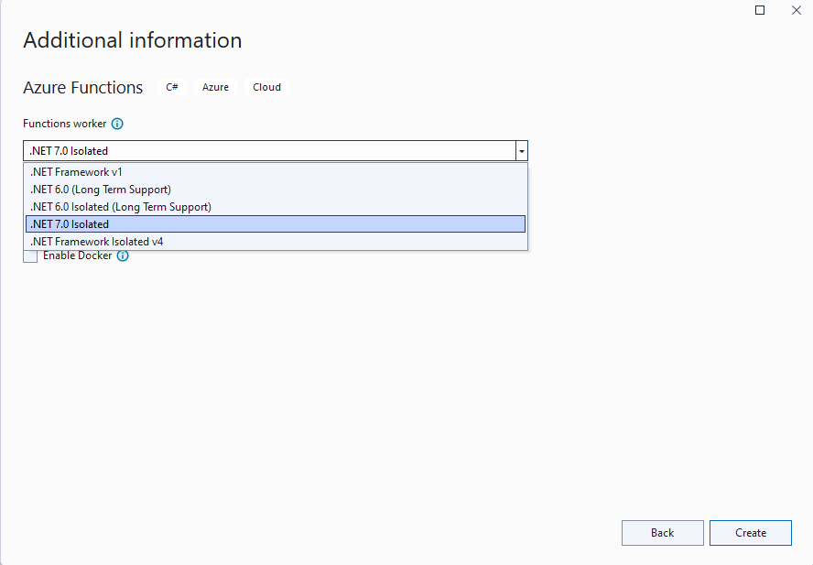
.NET 7 Only Supports Isolated

Slide 89
Best Practices
Advanced Serverless Workshop - Azure

Slide 90
Configure Storage Correctly
Create storage account in same region
Notes:
Functions requires a storage account be associated with your function app. The storage account connection is used by the Functions host for operations such as managing triggers and logging function executions. It’s also used when dynamically scaling function apps. A misconfigured file system or storage account in your function app can affect the performance and availability of your functions.
To reduce latency, create the storage account in the same region as the function app

Slide 91
Configure Storage Correctly
Create storage account in same region
Use a separate storage account
Notes:
To improve performance in production, use a separate storage account for each function app. This is especially true with Durable Functions and Event Hub triggered functions.

Slide 92
Configure Storage Correctly
Create storage account in same region
Use a separate storage account
Do not enable Data Lake Storage
Notes:
For Event Hub triggered functions, do not use an account with Data Lake Storage enable

Slide 93
Organize your functions
Performance and Scaling
Notes:
As part of your solution, you likely will develop and publish multiple functions. These functions are often combined into a single function app, but they can also run in separate function apps. In Premium and Dedicated (App Service) hosting plans, mulitple function apps can also share the same resources by running in the same plan. How you group your functions and function apps can impact the performance, scaling, configuration, deployment, and security of your overall solution.
Organize functions for performance and scaling
Each function that you create has a memory footprint. While this footprint is usually small, having too many functions within a function app can lead to slower startup of your app on new instance. It also means that the overall memory usage of your function app might be higher. It is hard to say how many functions should be in a single appl, which depends on your particular workload. However, if your function stores a lot of data in memory, consider having fewer functions in a single app.

Slide 94
Organize your functions
Performance and Scaling
Configurations and Deployment
Notes:
Organize functions for configurations and deployment
If you have some functions that need custom configurations, consider moving them into their own function app.

Slide 95
Organize your functions
Performance and Scaling
Configurations and Deployment
Privilege
Notes:
Organize functions by privilege
Connection stings and credentials stored in application settings gives all of the function in the function app the same set of permissions in the associated resource. Consider minimizing the number of ucntions with access to specific credentials by moving functions tha tdo not use those credentials to a separate function app.

Slide 96
Monitor effectively
AzureWebJobs
Dashboard
Notes:
Azure Functions offers built-in integration with Azure Application Insights to monitor your function execution and traces written from your code. You should be aware of the following considerations when using Application Insights integration to monitor your functions:
Make sure that AzureWebJobsDashboard application setting is removed. This setting was supported in older version of Functions. If it exists, remove AzureWebJobDashboard improves performance of your functions.

Slide 97
Monitor effectively
AzureWebJobs
Dashboard
Adjust Sampling Settings
Notes:
Review the Application Insight logs. If data you expect to find is missing, consider adjusting the sampling setting to better capture your monitoring scenario. You can use the excludedTypes setting to exclude certain types from sampling, such as Request or Exception.

Slide 98
Build for scalability
Share and mange connections
Notes:
Share and manage connections
Reuse connection to external resources whenever possible.

Slide 99
Build for scalability
Share and mange connections
Avoid blocking calls
Notes:
Use async code but avoid blocking calls
Asynchronous programming is a recommended best practice, especially when blocking I/O operations are involved.
In C#, always avoid referencing the Result property or calling Wait method on a Task instance. This approach can lead to thread exhaustion.

Slide 100
Build for scalability
Share and mange connections
Avoid blocking calls
Receive messages in batch
Notes:
Receive messages in batch whenever possible
Some triggers like Event Hubs enable receiving a batch of messages on a single invocation. Batching messages has much better performance. You can configure the max batch size in the host.json file.

Slide 101
Build for scalability
Share and mange connections
Avoid blocking calls
Receive messages in batch
Write defensive functions
Notes:
Assume your function could encounter an exception at any time. Design your functions with the ability to continue from a previous fail point during the next execution. Consider a scenario that requires the following actions:
Query for 10,000 rows in a database.
Create a queue message for each of those rows to process further down the line.
Depending on how complex your system is, you may have: involved downstream services behaving badly, networking outages, or quota limits reached, etc. All of these can affect your function at any time. You need to design your functions to be prepared for it.
How does your code react if a failure occurs after inserting 5,000 of those items into a queue for processing? Track items in a set that you’ve completed. Otherwise, you might insert them again next time. This double-insertion can have a serious impact on your work flow, so make your functions idempotent.

Slide 102
Performance and reliability
Avoid long running functions
Notes:
Avoid long running functions
Large-long-running functions can cause unexpected timeout issues. Whenever possible, refactor large functions into smaller function sets that work together and return responses fast. For example, a webhook or HTTP trigger function might require an acknowledgement response within a certain time limit; it’s common for webhooks to require an immediate response. You can pass the HTTP trigger payload into a queue to be processed by a queue trigger function. This approach lets you defer the actual work and return an immediate response.

Slide 103
Performance and reliability
Avoid long running functions
Cross function communication
Notes:
Cross function communication
Durable Functions and Azure Logic Apps are built to manage state transitions and communication between multiple functions.
If not using Durable Functions or Logic Apps to integrate with multiple functions, it’s best to use storage queues for cross-function communication. The main reason is that storage queues are cheaper and much easier to provision than other storage options.
Service Bus topics are useful if your require message filtering before processing.
Event hubs are useful to support high volume communications.

Slide 104
Performance and reliability
Avoid long running functions
Cross function communication
Write functions to be stateless
Notes:
Write functions to be stateless
Functions should be stateless and idempotent if possible. Associate any required state information with your data. For example, an order being processed would likely have an associated state member. A function could process an order based on that state while the function itself remains stateless.
Idempotent functions are especially recommended with timer triggers. For example, if you have something that absolutely must run once a day, write it so it can run anytime during the day with the same results. The function can exit when there’s no work for a particular day. Also if a previous run failed to complete, the next run should pick up where it left off.

Slide 105
Demos
Advanced Serverless Workshop - Azure

Slide 106


Drone Telemetry

Slide 107
Portfolio Management
Response
Builder
Upload
Monitor
Marketing API

Slide 108
Thank You
chadgreen@chadgreen.com
TaleLearnCode
ChadGreen.com
ChadGreen & TaleLearnCode
ChadwickEGreen

